Slide 1

Big Data Infrastructure
CS 489/698 Big Data Infrastructure (Winter 2017)
Week 8: Data Mining (1/4)
February 28, 2017
Jimmy Lin
David R. Cheriton School of Computer Science
University of Waterloo
These slides are available at http://lintool.github.io/bigdata-2017w/
This work is licensed under a Creative Commons Attribution-Noncommercial-Share Alike 3.0 United States See http://creativecommons.org/licenses/by-nc-sa/3.0/us/ for details

Slide 2
Structure of the Course
Analyzing Text
Analyzing Relational Data
Analyzing Graphs
Data Mining
“Core” framework features and algorithm design

Slide 3
Learn new buzzwords!
Descriptive vs. Predictive Analytics

Slide 4
external APIs
users
users
Frontend
Frontend
Frontend
Backend
Backend
Backend
OLTP database
OLTP database
OLTP database
ETL (Extract, Transform, and Load)
“Data Lake”
Data Warehouse
Other tools
SQL on Hadoop
“Traditional”
BI tools
data scientists

Slide 5
Supervised Machine Learning
The generic problem of function induction given sample instances of input and output
Focus today
Classification: output draws from finite discrete labels
Regression: output is a continuous value
This is not meant to be an exhaustive treatment of machine learning!

Slide 6

Classification
Source: Wikipedia (Sorting)

Slide 7
Applications
Spam detection
Sentiment analysis
Content (e.g., topic) classification
Link prediction
Document ranking
Object recognition
Fraud detection
And much much more!

Slide 8
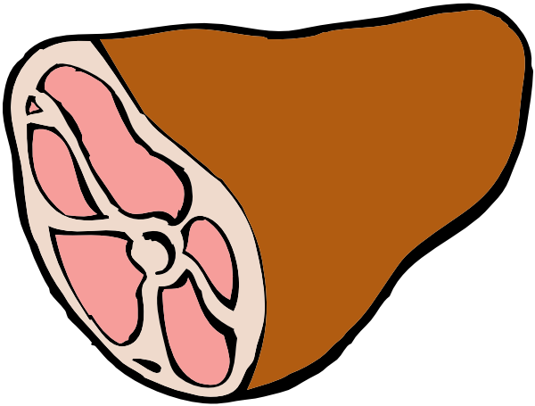

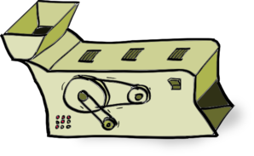
Supervised Machine Learning
training
testing/deployment
training data
Model
?
Machine Learning Algorithm

Slide 9
Feature Representations
Who comes up with the features?
How?
Objects are represented in terms of features:
“Dense” features: sender IP, timestamp, # of recipients, length of message, etc.
“Sparse” features: contains the term “viagra” in message, contains “URGENT” in subject, etc.

Slide 10
Applications
Spam detection
Sentiment analysis
Content (e.g., genre) classification
Link prediction
Document ranking
Object recognition
Fraud detection
And much much more!
Features are highly application-specific!

Slide 11
Components of a ML Solution
Data
logistic regression, naïve Bayes, SVM, random forests, perceptrons, neural networks, etc.
Features
Model
gradient descent, stochastic gradient descent, L-BFGS, etc.
Optimization
What “matters” the most?

Slide 12
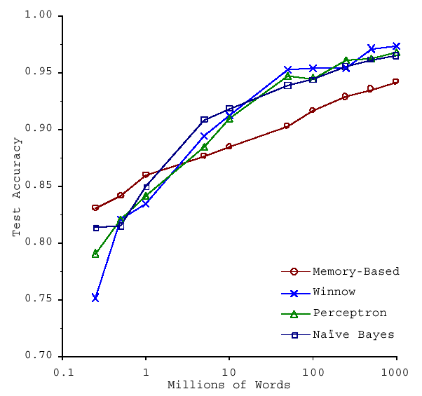
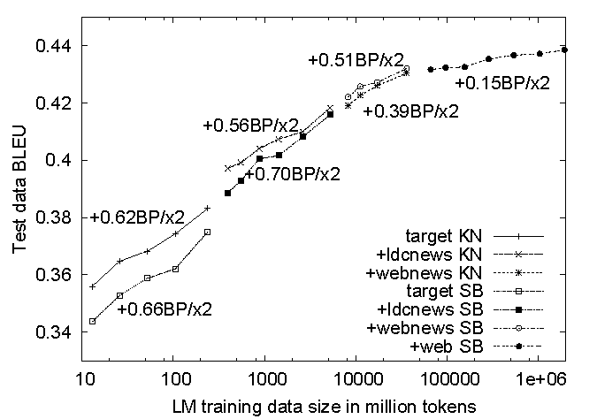
No data like more data!
(Banko and Brill, ACL 2001)
(Brants et al., EMNLP 2007)

Slide 13
What’s the deal with neural networks?
Data
Features
Model
Optimization

Slide 14
Limits of Supervised Classification?
Why is this a big data problem?
Isn’t gathering labels a serious bottleneck?
Solutions
Crowdsourcing
Bootstrapping, semi-supervised techniques
Exploiting user behavior logs
The virtuous cycle of data-driven products

Slide 15
Virtuous Product Cycle
a useful service
$ (hopefully)
transform insights into action
analyze user behavior to extract insights
Google.
Facebook.
Twitter.
Amazon.
Uber.
data products
data science

Slide 16
Supervised Binary Classification
Restrict output label to be binary
Yes/No
1/0
Binary classifiers form primitive
building blocks for multi-class problems…

Slide 17
Binary Classifiers as Building Blocks
Example: four-way classification
One vs. rest classifiers
Classifier cascades
A or not?
A or not?
B or not?
B or not?
C or not?
C or not?
D or not?
D or not?

Slide 18
The Task
label
Given:
(sparse) feature vector
Induce:
Such that loss is minimized
loss function
Typically, we consider functions of a parametric form:
model parameters

Slide 19
Key insight: machine learning as an optimization problem!
(closed form solutions generally not possible)

Slide 20
Gradient Descent: Preliminaries
Rewrite:
Compute gradient:
“Points” to fastest increasing “direction”
*
So, at any point:
* caveats

Slide 21
Gradient Descent: Iterative Update
Start at an arbitrary point, iteratively update:
We have:

Slide 22
Intuition behind the math…
New weights
Old weights
Update based on gradient

Slide 23
Gradient Descent: Iterative Update
Start at an arbitrary point, iteratively update:
We have:
Lots of details:
Figuring out the step size
Getting stuck in local minima
Convergence rate
…

Slide 24
Gradient Descent
Repeat until convergence:
Note, sometimes formulated as ascent but entirely equivalent

Slide 25
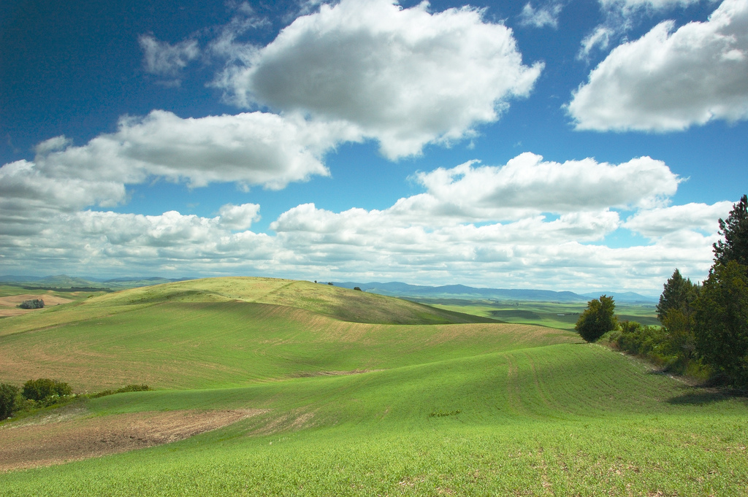
Gradient Descent
Source: Wikipedia (Hills)

Slide 26
Even More Details…
Gradient descent is a “first order” optimization technique
Often, slow convergence
Newton and quasi-Newton methods:
Intuition: Taylor expansion
Requires the Hessian (square matrix of second order partial derivatives): impractical to fully compute

Slide 27
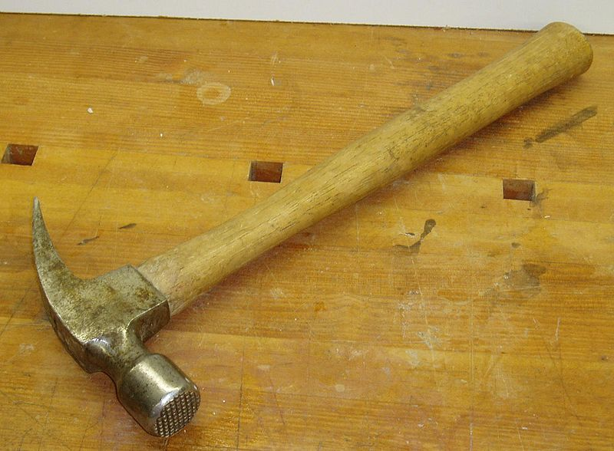
Logistic Regression
Source: Wikipedia (Hammer)

Slide 28
Logistic Regression: Preliminaries
Given:
Define:
Interpretation:

Slide 29
Relation to the Logistic Function
After some algebra:
The logistic function:

Slide 30
Training an LR Classifier
Maximize the conditional likelihood:
Define the objective in terms of conditional log likelihood:
We know:
So:
Substituting:

Slide 31
LR Classifier Update Rule
Take the derivative:
General form of update rule:
Final update rule:

Slide 32
Lots more details…
Regularization
Different loss functions
…
Want more details? Take a real machine-learning course!

Slide 33
MapReduce Implementation
mappers
single reducer
compute partial gradient
mapper
mapper
mapper
mapper
reducer
iterate until convergence
update model

Slide 34
Shortcomings
Hadoop is bad at iterative algorithms
High job startup costs
Awkward to retain state across iterations
High sensitivity to skew
Iteration speed bounded by slowest task
Potentially poor cluster utilization
Must shuffle all data to a single reducer
Some possible tradeoffs
Number of iterations vs. complexity of computation per iteration
E.g., L-BFGS: faster convergence, but more to compute

Slide 35
Spark Implementation
val points = spark.textFile(...).map(parsePoint).persist()
var w = // random initial vector
for (i <- 1 to ITERATIONS) {
val gradient = points.map{ p =>
p.x * (1/(1+exp(-p.y*(w dot p.x)))-1)*p.y
}.reduce((a,b) => a+b)
w -= gradient
}
What’s the difference?
compute partial gradient
mapper
mapper
mapper
mapper
reducer
update model

Slide 36

Questions?
Source: Wikipedia (Japanese rock garden)

